Slide 1

Final Project UART(tx) (Universal Asynchronous Receiver Transmitte)
By: Yusuf Ahmed Mohmed Abdelfadel
Supervised by: Moaz Khaled
S26-B8-FPGA-G8

Slide 2
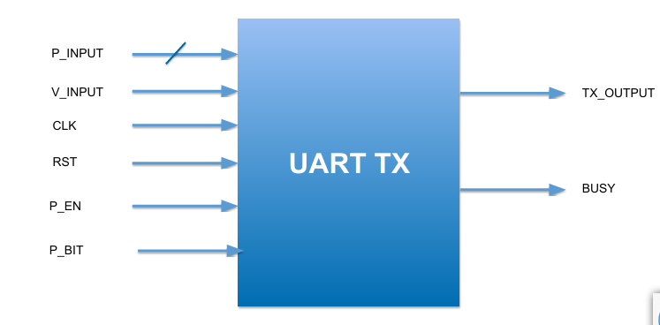
Project Overview
Project Overview The UART Transmitter (UART TX) is a digital RTL design that converts 8-bit parallel input data into a serial UART frame. The transmitter receives new data when the V_INPUT signal is high for one clock cycle and sends the complete frame through TX_OUT.
Main Features
8-bit parallel data input through P_DATA[7:0].
Serial data transmission through TX_OUT.
BUSY signal indicates that the transmitter is processing a frame.
Optional parity bit controlled by P_EN.
Even or Odd parity selected using P_BIT.
Asynchronous Active-Low Reset.
New data is not accepted while a frame is being transmitted.
Main Sub-Modules
1. Control (FSM) The main controller of the design. It manages the transmission sequence using five states: STEP0, STEP1, STEP2, STEP3, and STEP4.
2. Serializer Converts the 8-bit parallel input data into a serial bit stream and provides the data bits sequentially.
3. Parity Calculator Generates the parity bit according to the selected parity mode: Even or Odd.
4. MUX Selects the appropriate signal according to the current FSM state and sends it to TX_OUT.

Slide 3
Project Overview
UART Frame Structure START → DATA → OPTIONAL PARITY → STOP The TX_OUT line remains HIGH when the transmitter is idle.
FSM Sequence STEP0 → STEP1 → STEP2 → STEP3 → STEP4 → STEP0 STEP0: Beginning / Idle STEP1: Start Bit STEP2: Data Bits STEP3: Parity Bit STEP4: Stop Bit / End
Top Module Data Flow P_DATA → Serializer → serial_out ┐ P_DATA → Parity Calculator → parity_bit ├→ MUX → TX_OUT V_INPUT, P_EN → Control FSM → state ┘ Control FSM → BUSY, load_data, shift_en
Presentation Script "This is our UART TX Top Module. Its main purpose is to integrate the four main sub-modules of our design: the Control FSM, Serializer, Parity Calculator, and MUX. The input data is received through the 8-bit P_DATA bus when V_INPUT is high. The Control module manages the transmission process and generates the required control signals. The Serializer converts the parallel data into a serial bit stream, while the Parity Calculator generates the selected parity bit. Finally, the MUX selects the correct signal according to the current FSM state and sends it to TX_OUT. Therefore, the Top Module connects all sub-modules together to implement the complete UART Transmitter."
Key Design Concept Control = the brain of the design Serializer = converts parallel data to serial data Parity Calculator = generates the parity bit MUX = selects the transmitted signal Top Module = integrates and connects all four sub-modules

Slide 4
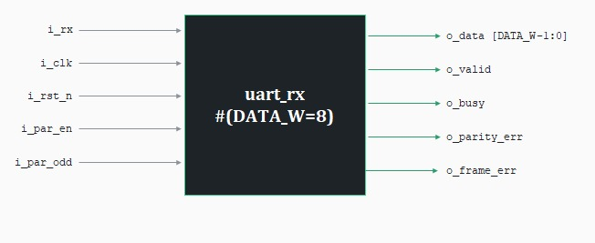
Objective_rx

Slide 5
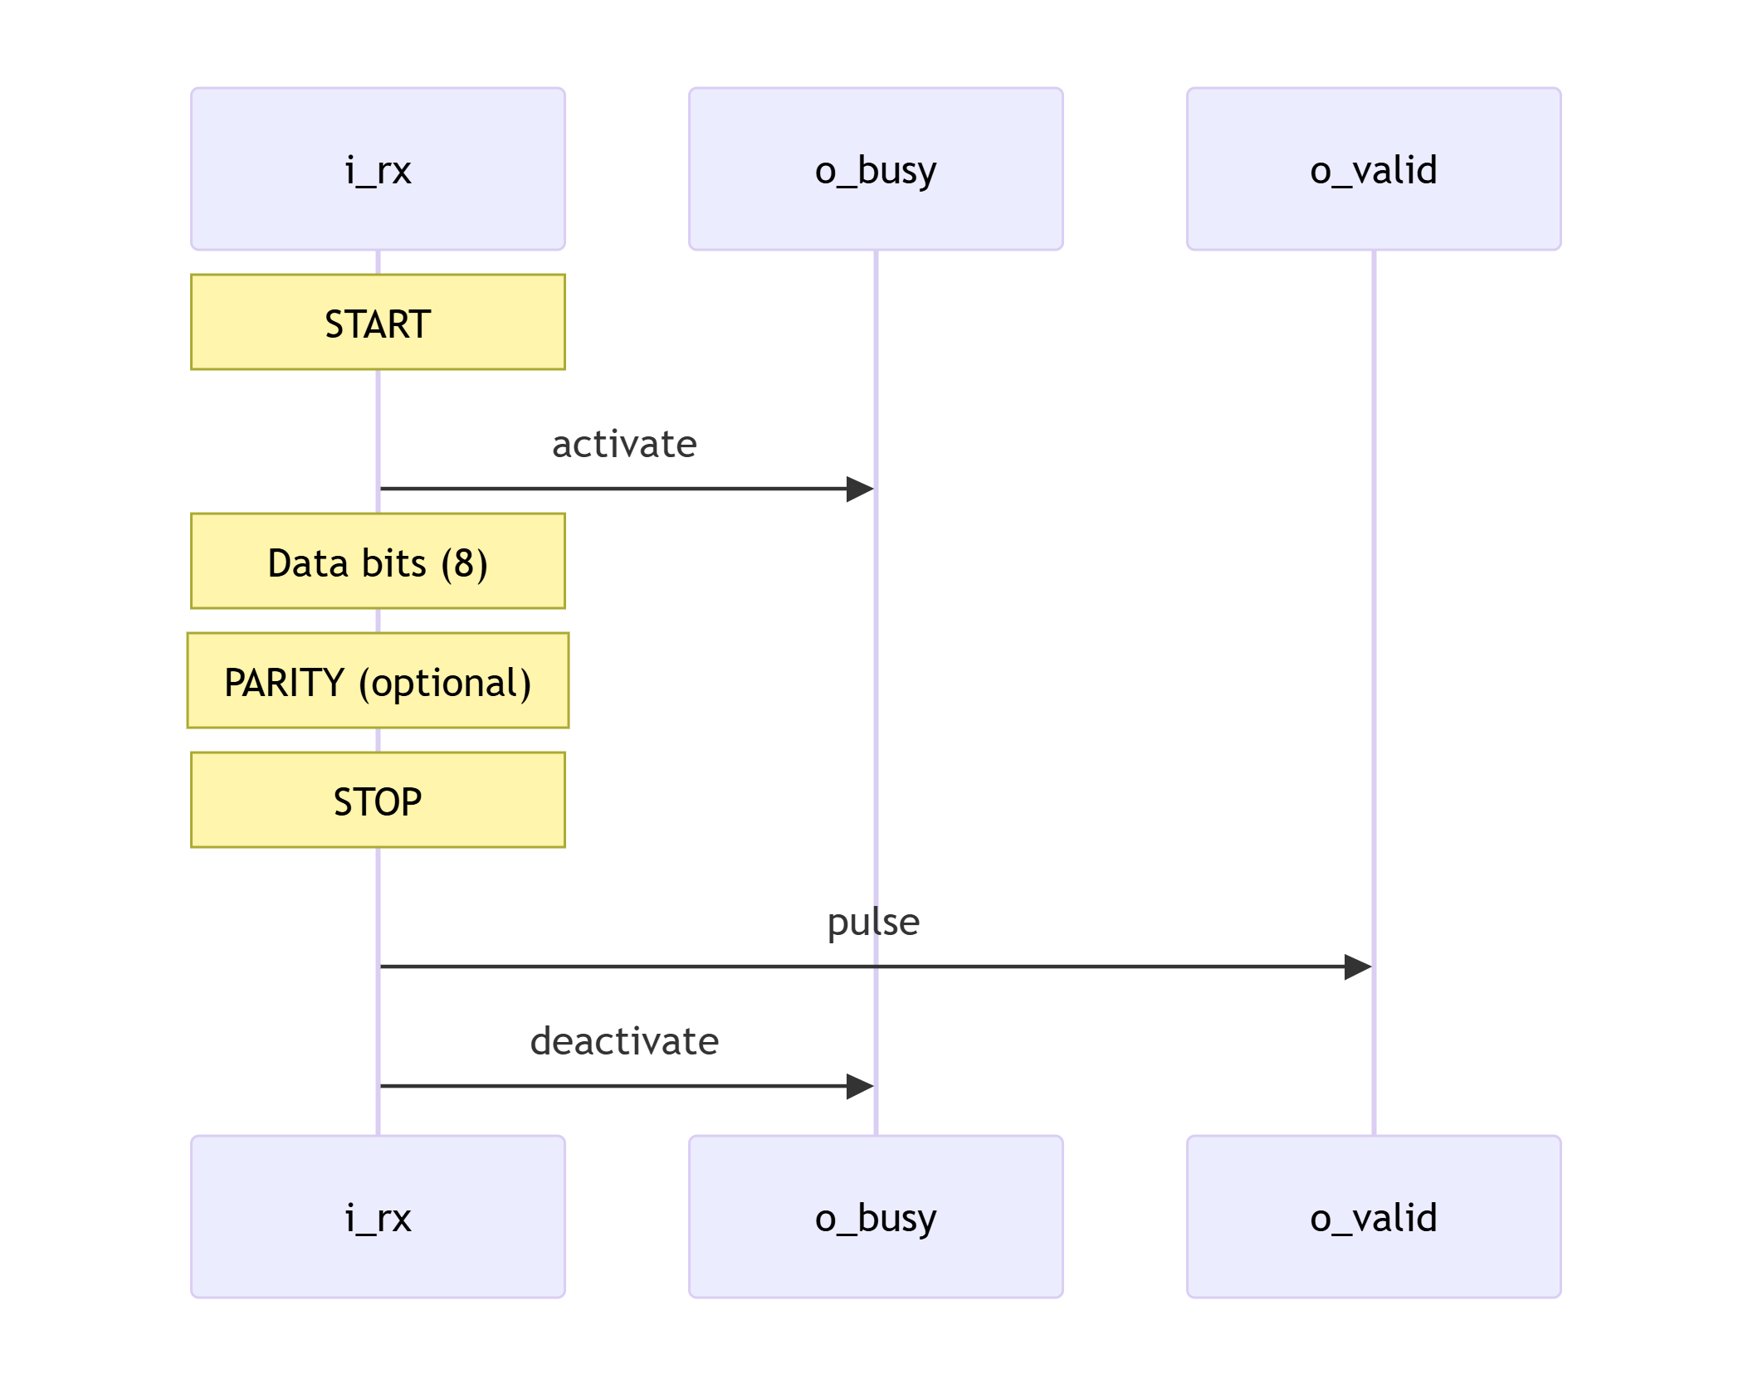
uart_rx —Required Behaviour
- After reset → All outputs are `0`.
- Start bit → Detected **only** when idle. Zeros inside the data byte are ignored.
- Busy → Stays `1` from the start bit until the frame ends.
- Valid & Data → `o_valid` pulses for **1 cycle** with the received byte on `o_data`.
- Frame Error → Pulses with `o_valid` if the stop bit is `0` (not `1`).
- Parity Error → Pulses with `o_valid` if parity is enabled and doesn't match. Always `0` when disabled.
- Always deliver → Even if there is an error, `o_valid` still pulses and the byte is still delivered.

Slide 6
UART RX-TX Communication – Summary
1. UART Frame (LSB First)
Idle: 1 (high)
Start: 0 (1 bit)
Data: 8 bits (LSB first)
Parity: optional (par_en)
Stop: 1 (≥1 bit)
2. Testbench Role
Connects uart_tx and uart_rx via a wire (line)
Sends random bytes with various parity settings
Injects parity and framing errors by forcing the line
Compares received data + errors against expected queue
Reports score (correct frames / total)
3. Root Cause of Failures
Transmitter: shift_en asserted on same cycle as data output → LSB lost (bytes left‑shifted)
Receiver: Sampled on posedge (same as TX) → race condition; extra START state delayed sampling
4. Final Fixes
TX control.sv: Split DATA into DATA_OUT (output current bit) and DATA_SHIFT (shift to next)
MUX: Updated to handle new states
RX Controller / Datapath:
Sample on negedge (middle of bit)
Remove START state; go directly IDLE → DATA
uart_rx.sv: Connect i_rx directly (no synchroniser) – negedge sampling avoids metastability

Slide 7
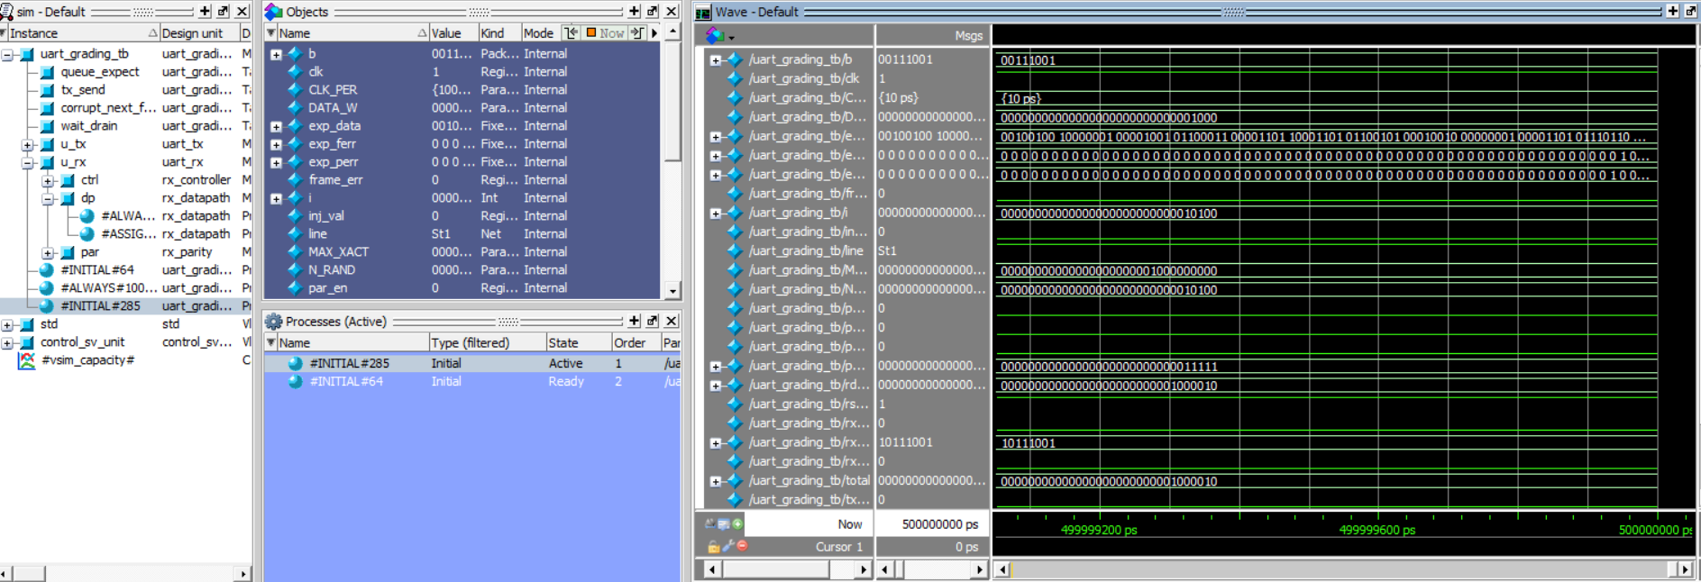
Wave form

Slide 8
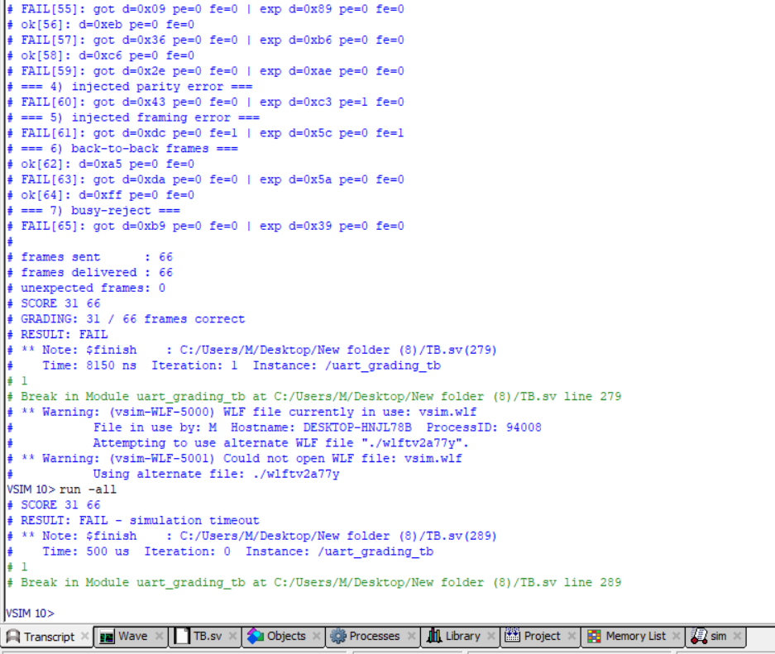
Output

Slide 9
Thank you

